Slide 1
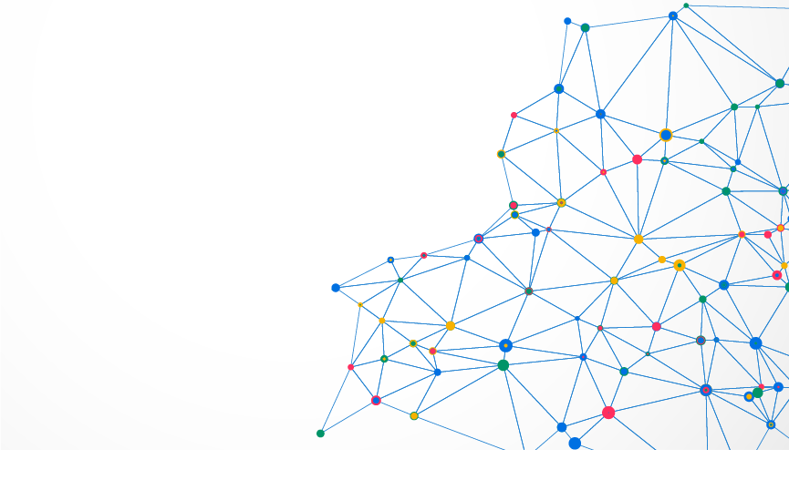
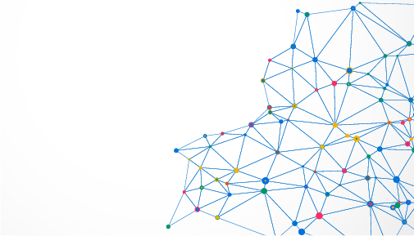

CORPORATE PROFILE

Slide 2

TABLE OF CONTENT
1. Introduction about Clever Group
Member companies
Milestones
2. Member Companies
CleverAds
Clever Review (REVU)
Orion Media/ NAH
ADOP Viet Nam
AdTech Corp
Contact
3
4
5
6
8
14
20
23
26
28

Slide 3


1. INTRODUCTION ABOUT CLEVER GROUP
Clever Group is a pioneer in new-generation advertising services and technologies in Vietnam. Formerly known as CleverAds and founded in 2008, after 11 years of development, Clever Group ever since has quickly become a leading brand in marketing, digital advertising, advertising technology in Vietnam as well as Southeast Asia. Clever Group is currently having offices in markets of Vietnam, Indonesia, Philippines and Myanmar.
CleverGroup là đơn vị tiên phong về các dịch vụ và công nghệ quảng cáo thế hệ mới tại Việt Nam.
Tiền thân là Công ty cổ phần Quảng cáo Thông Minh - CleverAds, thành lập năm 2008, sau 11 năm đã phát triển thành CleverGroup và nhanh chóng trở thành thương hiệu hàng đầu trong lĩnh vực tiếp thị, quảng cáo số, công nghệ quảng cáo số tại Việt Nam cũng như khu vực Đông Nam Á.
CleverGroup hiện đang kinh doanh tại các thị trường Việt Nam, Indonesia, Philipines, Myanmar.
3

Slide 4
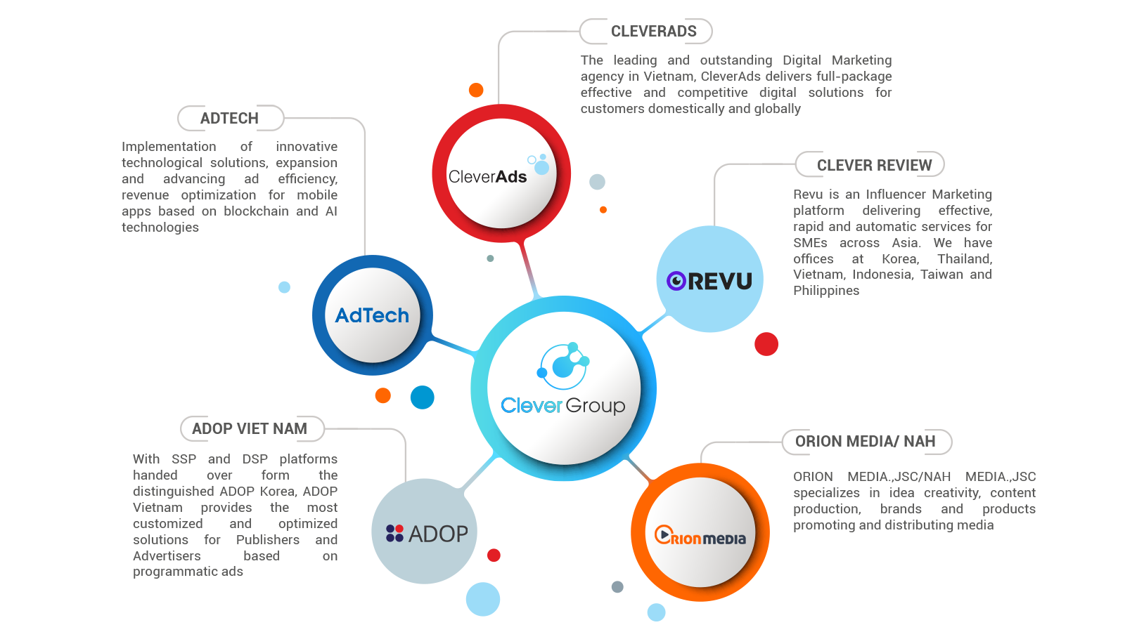
MEMBER COMPANIES
4
5

Slide 5
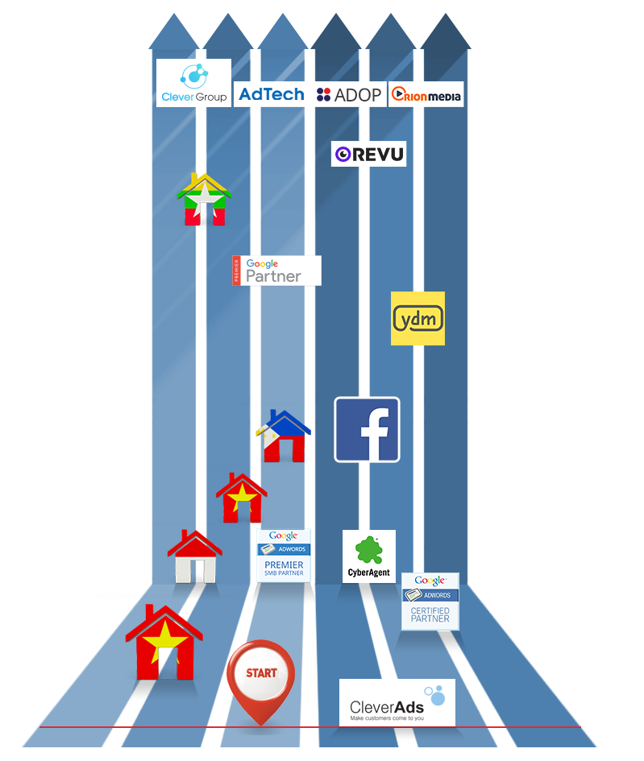
MILESTONES
Establishment of Clever Group
Co-Founder of ADOP Viet Nam
Establishment of AdTech
Invest in Orion Media
2019
Establishment of Clever Review (Revu)
2018
Establishment of Myanmar Branch
2017
New Premier Google Partner Logo 2016.
CleverAds hads won Google PSP Awards 2015 for 3 prizes:
Best Searching campaign
Best Youtube & Dissplay Campaign
Best Mobile Campaign
2016
Welcomed investment from Yello Digital Marketing
2015
Establishment of Philippines Branch
Officially became the first Facebook Authorized Reseller In VietNam
2013
Establishment of Da Nang Branch
2012
Establishment of Indonesia Branch
Officially became the first Google Premier SMB Partner In VietNam
Welcomed investment from Cyber Agent Ventures
2011
Became Google Certified Partner
2010
2009
Establishment of Ho Chi Minh City Branch
Start up
2008
5

Slide 6






2. MEMBER COMPANIES
.
7

Slide 7


CLEVERADS INTRODUCTION
8

Slide 8




CLEVERADS OVERVIEW
A leading company in Digital Marketing; premier partner of Google and Facebook in Vietnam. CleverAds delivers effective online marketing solutions with diverse advertising service system for thousands of SMBs across Asia.
6
6,000
Offices at 4 nations
Total customers
#1
5 continuous years ranking #1 of
Google Ads in Vietnam
Google Premier Partner
Facebook Authorized Reseller
Strategic Partner - Yello Digtal Marketing
Strategic Partner -Cyber Agent
TikTok Authorized Reseller
35%
Regular customers
9

Slide 9
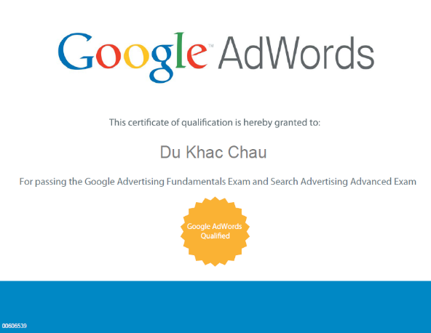
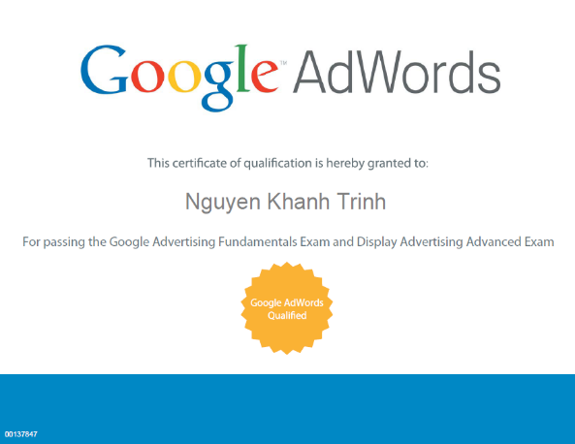
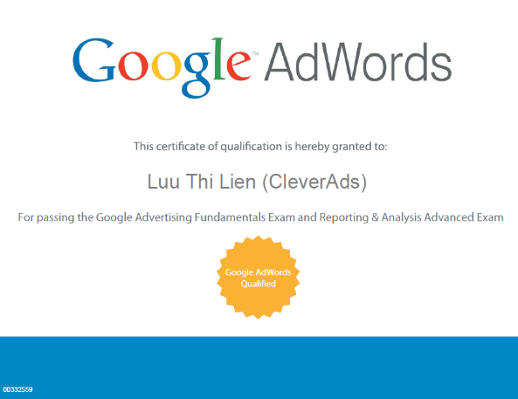
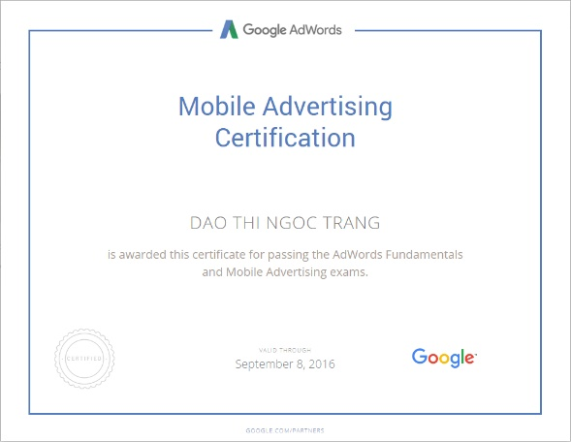
CERTIFICATES
Search Advertising Advanced
Recognition of advanced skills and knowledge in creating, managing, measuring, and optimizing Google Search Advertising campaigns.
Display Advertising Advanced
Recognition of advanced skills and knowledge in creating, managing, measuring, and optimizing Google Display Advertising campaigns.
Reporting & Analysis Advanced
Recognition of the skills and knowledge of creating, analyzing, and improving effectiveness of Google ads.
Mobile Advertising
Recognition of mobile advertising skills and knowledge, including formatting, bidding, advertising targeting, and campaign measuring and optimizing.
10

Slide 10


AWARDS
CleverAds was awarded 03 awards for Google Premier Partner - Google PSP Awards, namely:
Best Quality Adwords Account SouthEast Asia
Mobile Performance Champion SouthEast Asia
Display & Youtube Champion SouthEast Asia
11

Slide 11
































































FLAGSHIP CUSTOMERS
Telecommunication
Banking
Education
Airline
Real Estate
E-Commerce
Medicines
Appliances
Others
6

Slide 12





OTHER SERVICES OF CLEVERADS
Google Ads
Youtube Ads
Facebook Ads
Instagram Ads
TikTok Ads
Social Media &
Viral Marketing
Video Marketing
Reviewer Network
G Suite
Zalo Ads
Email
Banner Ads
Cốc Cốc Search
Wifi Ads
12

Slide 13






SERVICE QUALITY
CUSTOMER QUALIFICATION
75%
75%
70%
63%
68%
Customer satisfaction of CleverAds’ services increased rapidly between 4 years
2015 - 2018, reaching 75% in 2018, an increase of 7% from 2016
65%
60%
2015
2016 2018
CleverAds
Source: Netpop 2019
13

Slide 14
REVU INTRODUCTION
14

Slide 15
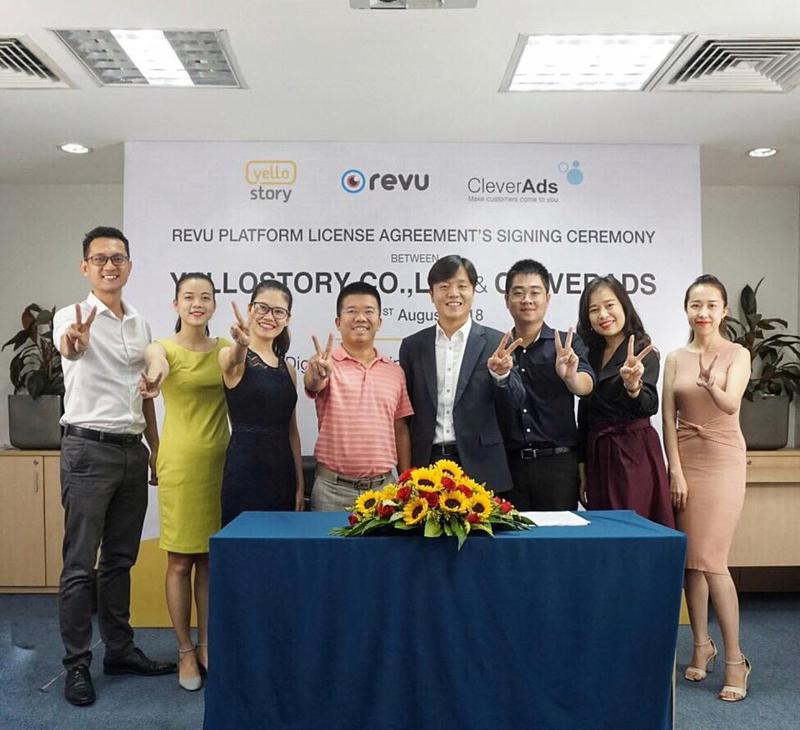




REVU OVERVIEW
REVU is an Influencer Marketing platform, which is viral marketing connecting advertising companies (Advertiser) and thousands of Reviewers (Micro Influencer) worldwide.
Founded in 2008 by Yello Story, Revu has been present in Korea, Thailand, Vietnam, Indonesia, Taiwan and the Philippines. Revu's vision is to become Asia's largest Influencer Marketing platform.
REVU VIETNAM
X
Revu Vietnam was established in cooperation with Yello Story (the leading social networking platform in Korea) and Clever Group (the innovative advertising group in Vietnam).
1 1 +
Nations
1 8 +
Member companies
1600 +
Employees
15

Slide 16




REVU PLATFORM
Revu is a Content Marketing Platform that acts as a bridge between the advertising agency (Advertiser) and thousands of Reviewers (Micro Influencer)
Reviewer
REVU
Businesses
Products searching
Purchase decision
With this way of consumption, the most effective marketing method is to use content created based on the consumers’ opinions. REVU will support customers to build Content Marketing campaigns from A to Z, from creating the essential content for advertising to analyzing data results.
16

Slide 17
REVU CAMPAIGN EXECUTION PROCESS
For effective campaign execution, REVU and businesses will coordinate to implement of the campaign according to the following process
Reviewer enrolment
Reviewer selection
Sample products
Campaign consultancy
Campaign setting
Campaign termination&acceptance
Review posting
Content creating
Report
17

Slide 18
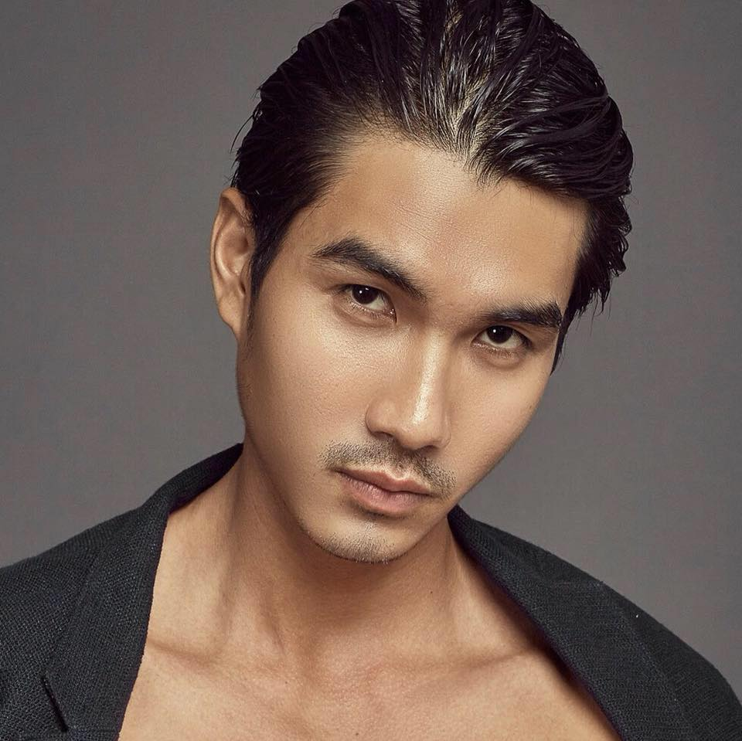



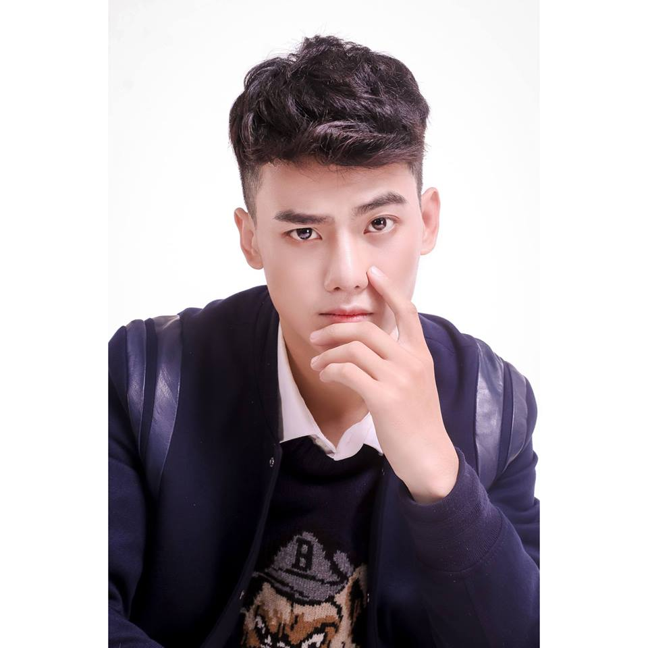
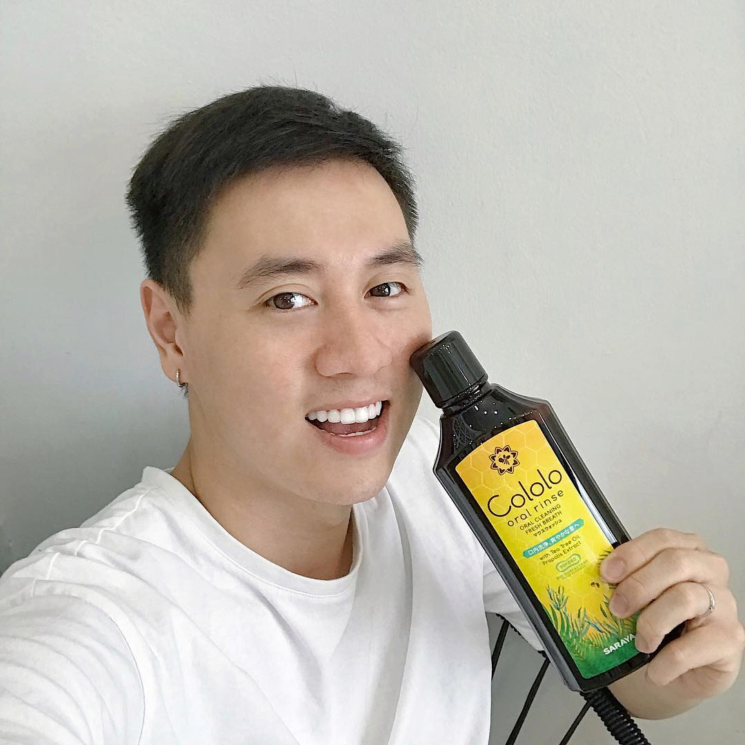





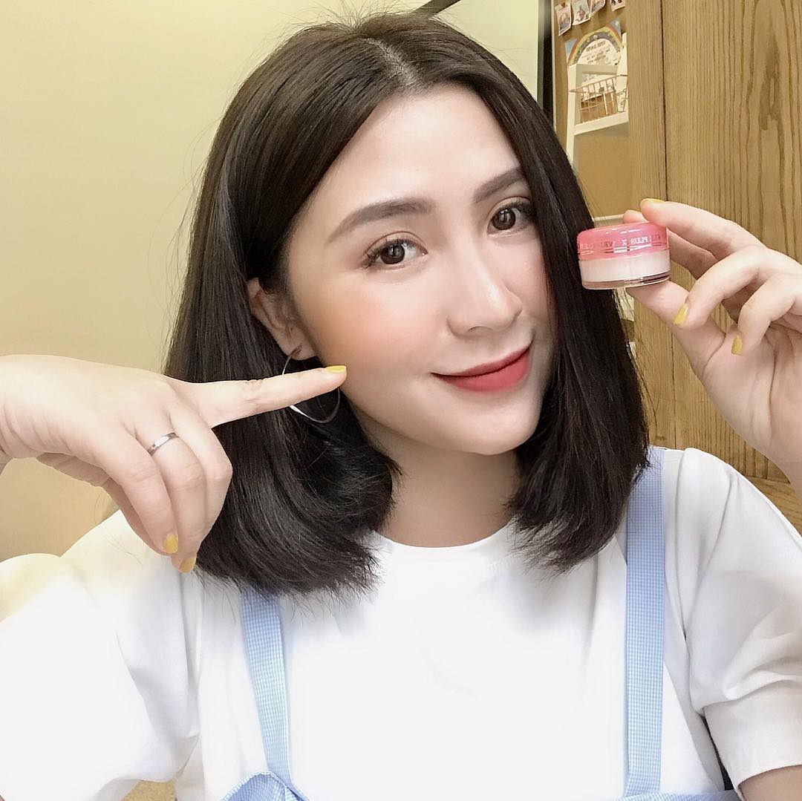









REVIEWER NETWORK IN DIVERSE FIELDS
Revu network has diversity of various fields from food, beauty, technology, fashion, entertainment, tourism and consumption.
18

Slide 19
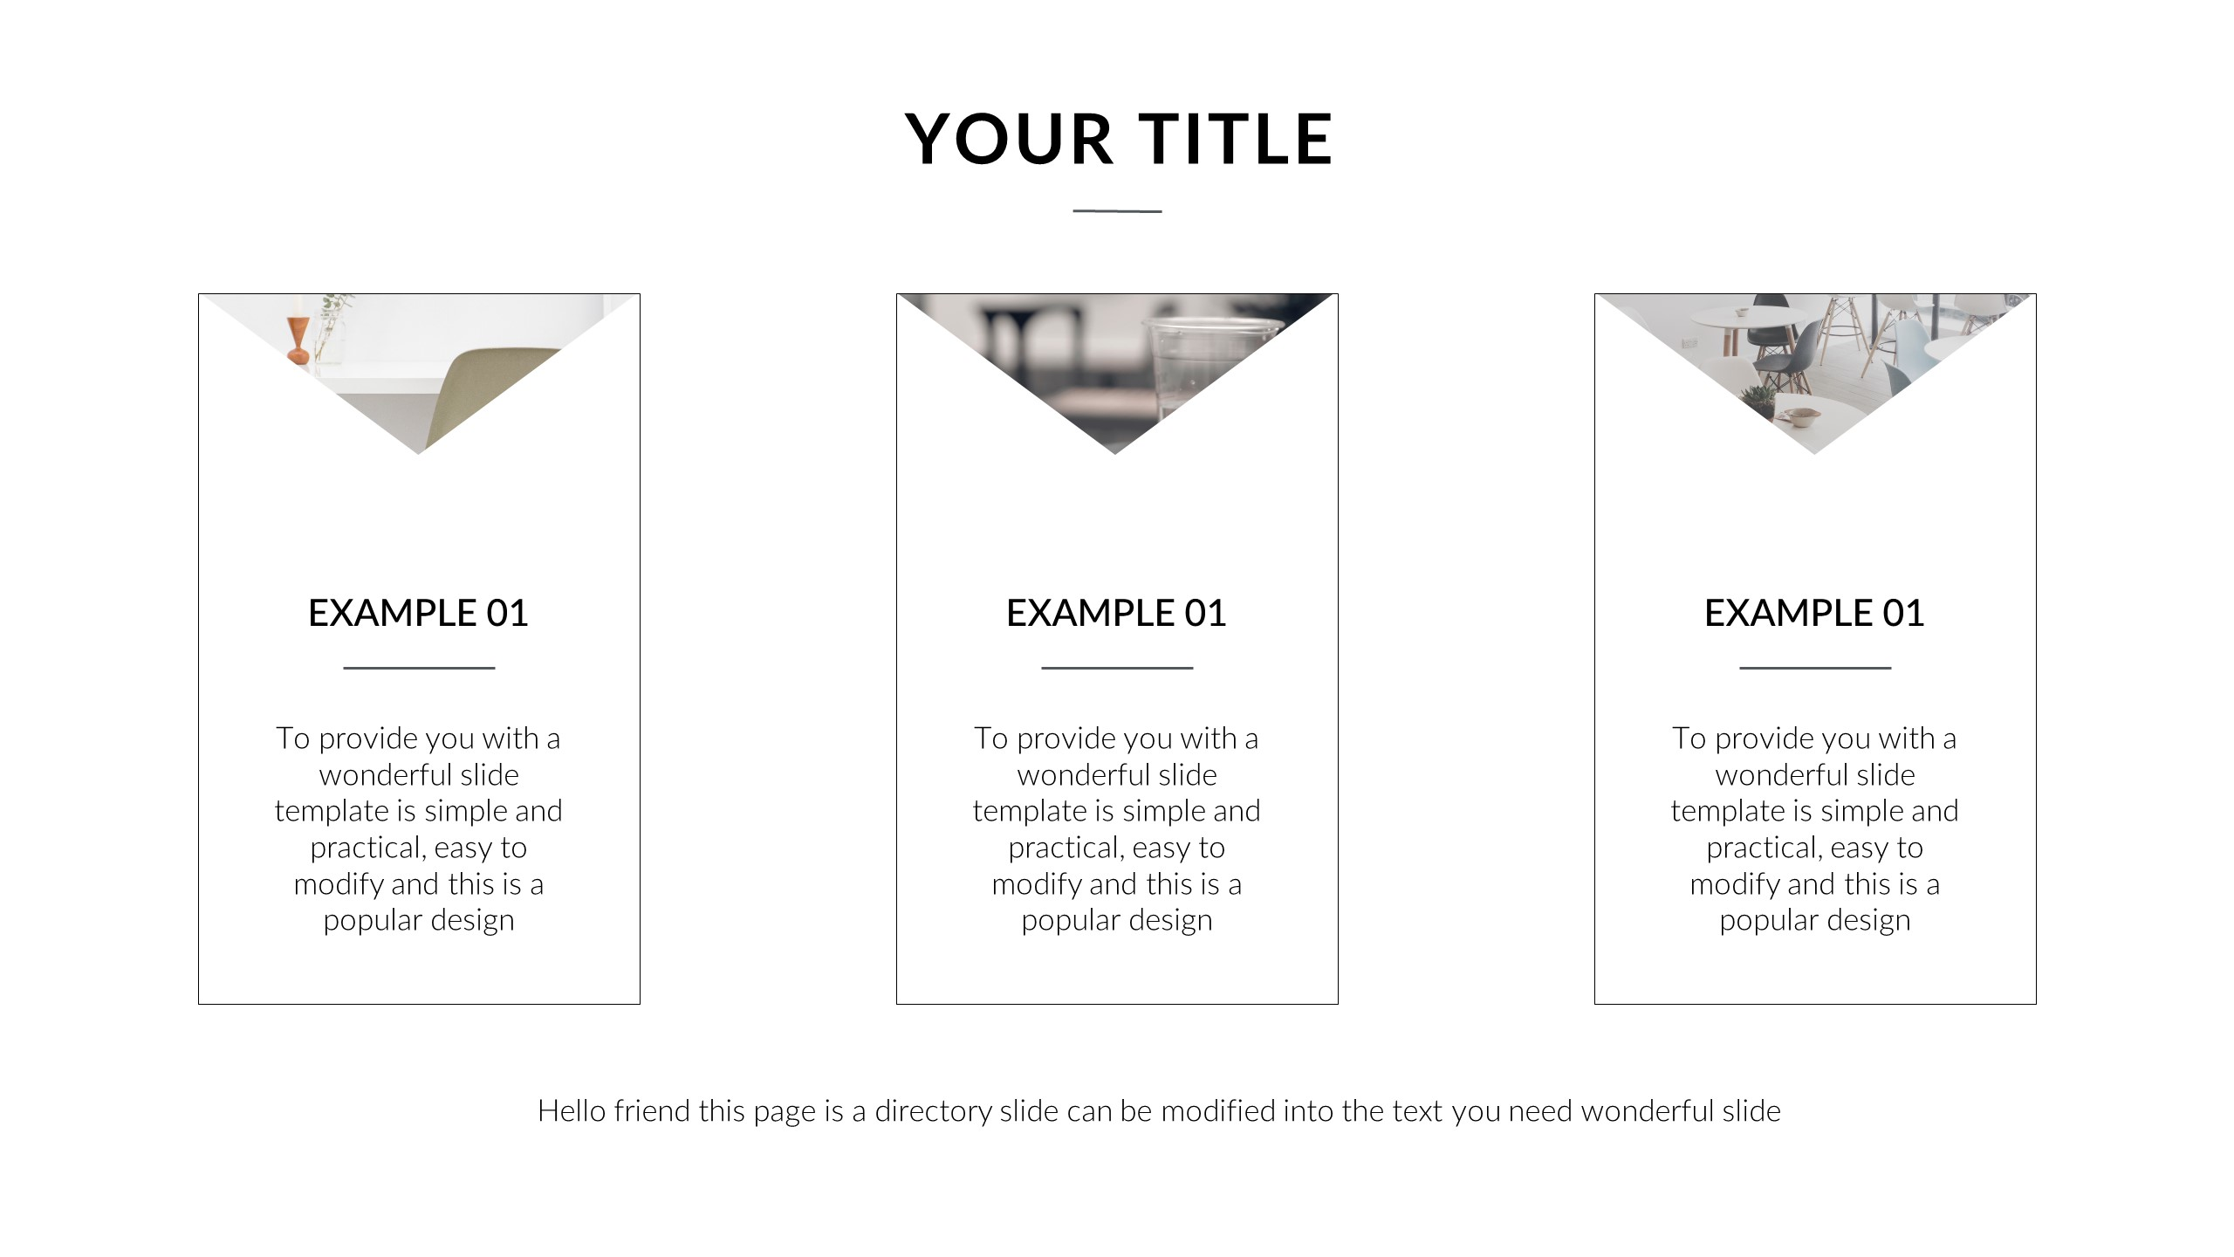
EFFECTIVE MEDIA CAMPAIGN CREATION
With a strict working process, Revu helps businesses tackle difficult issues.
Process and Time Managment
Expense Optimization
Target Customers
Businesses do not have to spend time to find suitable reviewers because Revu will help them carry out this activity.
Compared to famous people (KOLs), Reviewers at Revu charge a more reasonable price for all businesses.
Also, Revu separates the service packages with different price level for businesses to easily opt for.
Based on your business and product/service’s features, Revu chooses the Reviewer with characteristics and interests relevant to your business’s target group of customers.
19

Slide 20

ORION MEDIA & NAH
INTRODUCTION
20

Slide 21

ORION MEDIA & NAH INTRODUCTION
With the background of media technology expertizing in content creation and production, user data and technology, advertising through influencer KOLs, viral content, Orion Media & NAH provides customers solutions to promote and develop their brands at all stages, meeting their needs by full-packaged and economical service with 3 main platforms.
User technology and data: Using “content funnel” to create a community, collect user data, help businesses understand customer; all to effectively implement communication campaigns.
Content creation and production: Creating the most relevant, convincing content for each customer group. And build media content in various formats: Video (Viral Video, TVC, Review Video), status (text), photos, Gif animations, paintings etc
Ecosystem of content production and distribution: Approaching customers in the most efficient method
21

Slide 22
ORION MEDIA & NAH INTRODUCTION
Orion Media is a leading social media company providing services of advertising and content creation in Vietnam. Founded in 2016, Orion Media’s first platform is Trang TV - the YouTube channel that initiated the parodical music trend on Social Networks. Up to now, Trang TV has reached nearly 4 million followers on YouTube and Facebook totally; and updated until September 2019, Orion Media has owned more than 10 YouTube channels, 50 Fanpages, with multiple advantages:
Creating viral content, being highly viral, civilized and suitable for a diverse group of audience. Multiple videos produced by Orion Media have reached over 50 million views on Social Networks.
Orion Media's channel system is versatile in content and viewers with more than 30 million followers on Social Networks.
Development and management of KOLs / Influencers: With the founding team who are also influencers on social networks, Orion Media supports, develops and works with a network of over 5,000 KOLs and Micro Infuencers.
21

Slide 23



ORION MEDIA’S SERVICES
SOCIAL MEDIA CAMPAIGNS
Consult, propose strategies and implement an overall social media plan for businesses
CREATIVE ADVERTISING
Implement campaign with full-service package with diverse tools: Viral Video, TVC, Sit-com, Review Video
INFLUENCER MARKETING
Communication services, sales via Influencer on pioneering social networks in Vietnam
22

Slide 24
ADOP VIETNAM
INTRODUCTION
23

Slide 25



ADOP VIETNAM’S SERVICES
ADOP provides an optimal solution based on automated display ads for both Publishers and Advertisers
SSP (Supply Side Platform)
PROGRAMMATIC DEAL
AD EXCHANGE
With ADOP’s integrated Ad Server platform, you can easily create ad inventory, analyze content and test for ads effectiveness.
With ADOP, you can connect with the higgest valuable customers and access high-end inventory with solutions based on automated real-time auction transactions.
ADOP creates a market with optimal deals for both Publishers and Advertisers through DSP and SSP services.
24
24

Slide 26
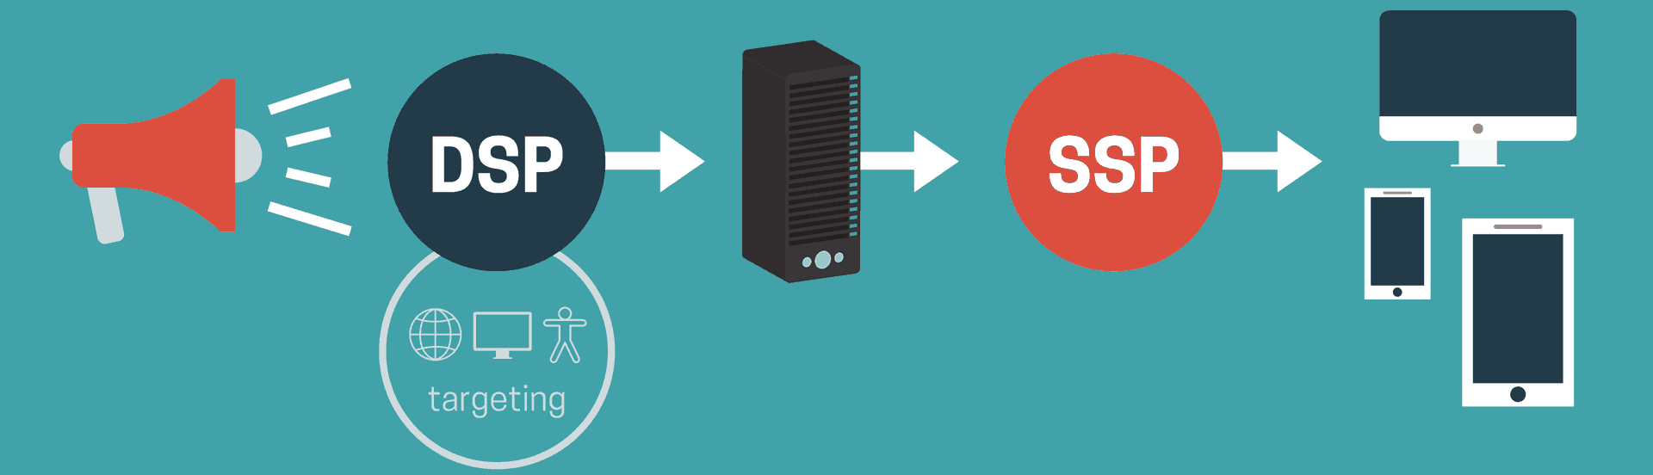
ADOP VIETNAM
PROVISION UNIFORM SOLUTION FOR INVENTORY MANAGEMENT
REVENUE OPTIMIZATION
PROFESSIONAL SUPPORT
CONTENT MANAGEMENT
Our platform is integrated with ad networks and demand partners at home nation and abroad, thus helping to optimize profits for your inventory.
With our patented technology and experience in advertising, we minimize policy violations and website errors.
We assist you in content distribution, so you can focus on creating the best content.
25

Slide 27
ADTECH CORP INTRODUCTION
26

Slide 28

AdTech Corp – a member of Clever Group: researching and deploying, optimization, automation, blockchain & AI technologies for mobile and website:
Improve advertising efficiency, optimize costs for customer communication campaigns
Research and expand new advertising channels and formats to increase coverage and effectiveness of media campaigns
Provide solutions to ensure brand safety for customers on online advertising channels
Increase correctness of measurement, analyze effectiveness of customer communication campaigns
Automate the marketing process for campaigns in accordance with the customers’ life cycle value.
27

Slide 29

OUR SINCERE THANK TO YOU!
Hanoi
Level 3, G1 Building – Five Star Garden, No. 02 Kim Giang, Thanh Xuan, Ha Noi
+84 24 7304 6066
+84 919 01 8448
Ho Chi Minh City
No.27 Thang Long, Ward 4, Tan Binh Dist., HCM
+84 28 73046066
+84 919 02 8448
Da Nang City
Level 2, 14-16-18 Nguyen Van Linh str, Hai Chau dist, Da Nang
+ 84 917 73 8448
Indonesia
Jakarta Branch: Jl. Tanah Abang 5, No. F3 RT 005 RW 02 Petojo Selatan Gambir Jakarta Pusat 10160
+62 21 2234 5963
Philippines
U1707, Cityland 10, Tower 1, 156 H.V. Dela Costa, Salcedo village, Makati City, Philippines.
+63-2-893-19-39 / +63-2-893-14-25
Myanmar
Unit 106/A1 , level 1 Aung Chan Thar Condo, Aung Chan Thar Road, Yankin Township, Yangon, Myanmar
28

